Slide 1
Comparison of Call Centre Predictive Dialer Algorithms
Rob Johnston

Slide 2

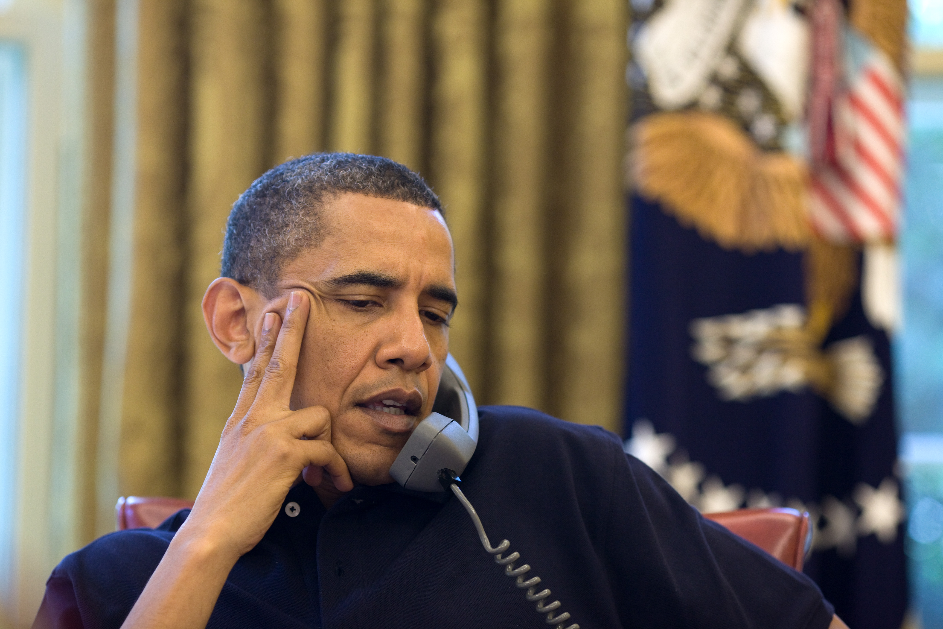
The Outbound Call Centre
I’m sorry, but I can’t talk, I’m a bit busy right now …
Public Telephone Network
http://www.acclaimimages.com/_gallery/_image_pages/0519-1010-0716-5642.html

Slide 3
Call Outcomes
Data from telemarketing campaign over 3 months

Slide 4
The Outbound Call Centre
A good time to call back? Try in a few weeks time …
Public Telephone Network
http://www.acclaimimages.com/_gallery/_image_pages/0519-1010-0716-5642.html

Slide 5
The Outbound Call Centre
A good time to call back? Try in a few weeks time …
Public Telephone Network
http://www.acclaimimages.com/_gallery/_image_pages/0519-1010-0716-5642.html

Slide 6
The Outbound Call Centre
A good time to call back? Try in a few weeks time …
Public Telephone Network
http://www.acclaimimages.com/_gallery/_image_pages/0519-1010-0716-5642.html

Slide 7
The Outbound Call Centre
A good time to call back? Try in a few weeks time …
Public Telephone Network
http://www.acclaimimages.com/_gallery/_image_pages/0519-1010-0716-5642.html

Slide 8
The Outbound Call Centre
A good time to call back? Try in a few weeks time …
Public Telephone Network
http://www.acclaimimages.com/_gallery/_image_pages/0519-1010-0716-5642.html

Slide 9
The Outbound Call Centre
A good time to call back? Try in a few weeks time …
Public Telephone Network
http://www.acclaimimages.com/_gallery/_image_pages/0519-1010-0716-5642.html

Slide 10
Predictive Dialer
Computer based dialing system that determines when a call should be made
Number calls based on
Prediction of agent availability
Estimated probability of a call being answered
Predictive dialer algorithm determines the dial level (number calls to make per second)

Slide 11
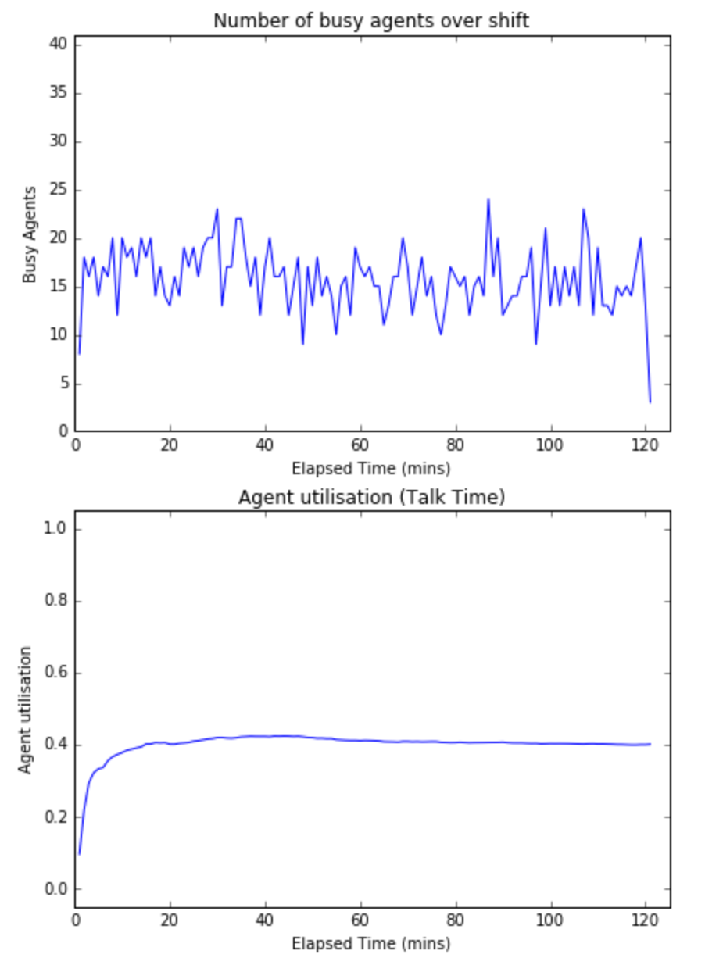
Maximising Agent Utilisation (1 call/sec)

Slide 12
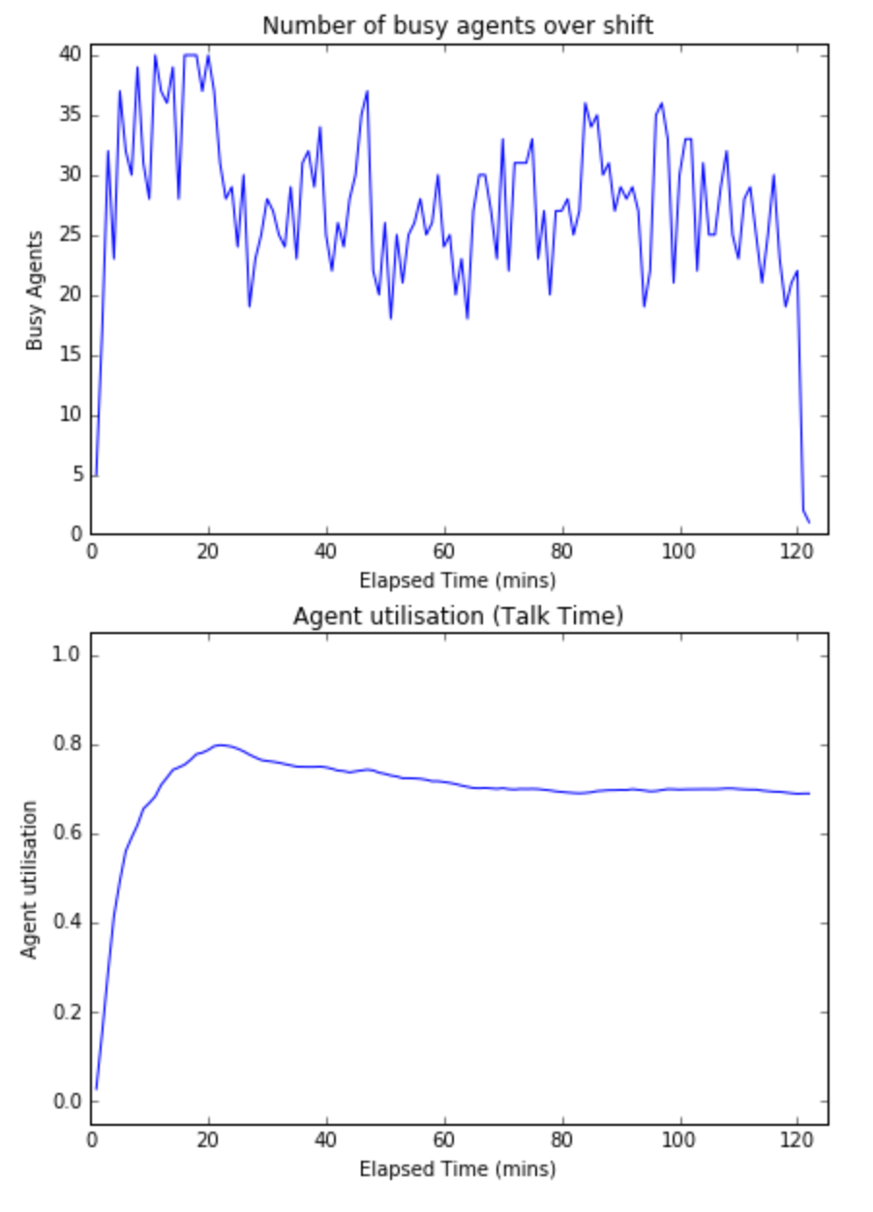
Maximising Agent Utilisation (5 call/sec)

Slide 13
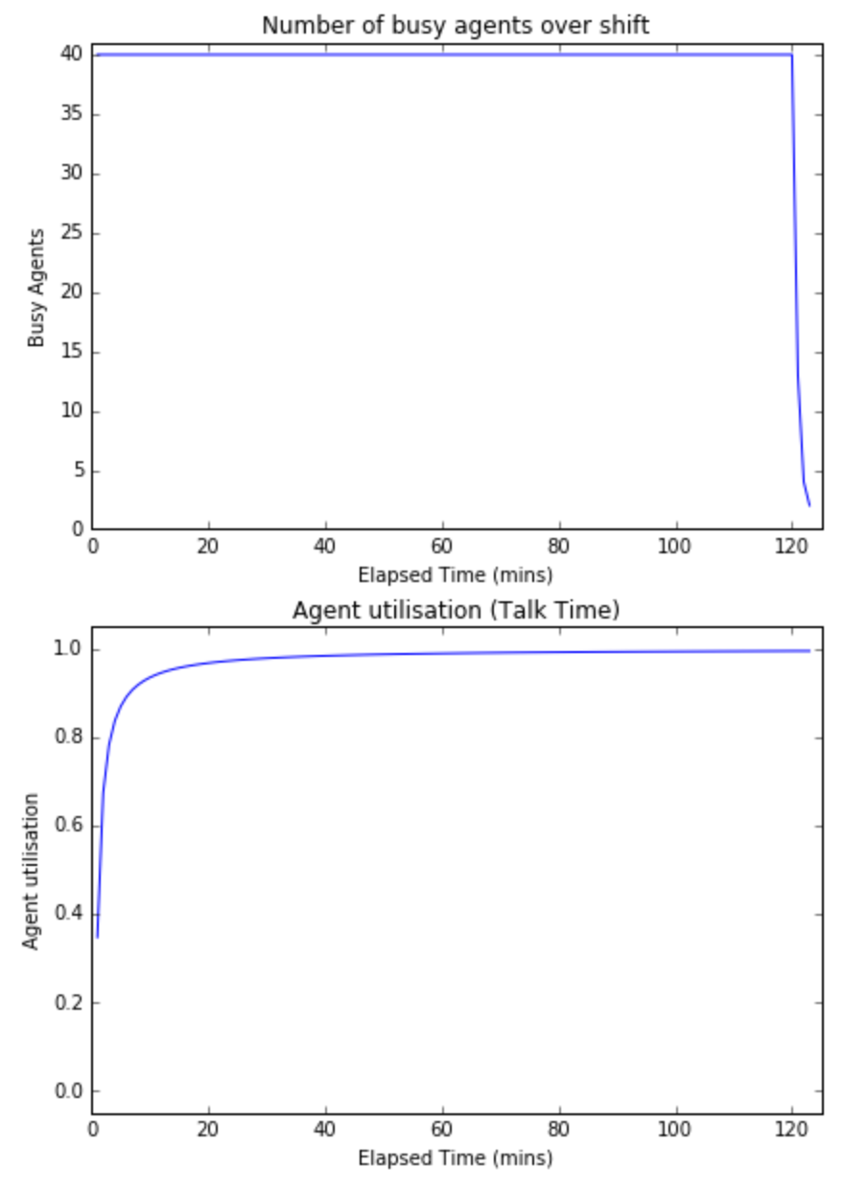
Maximising Agent Utilisation (10 call/sec)

Slide 14
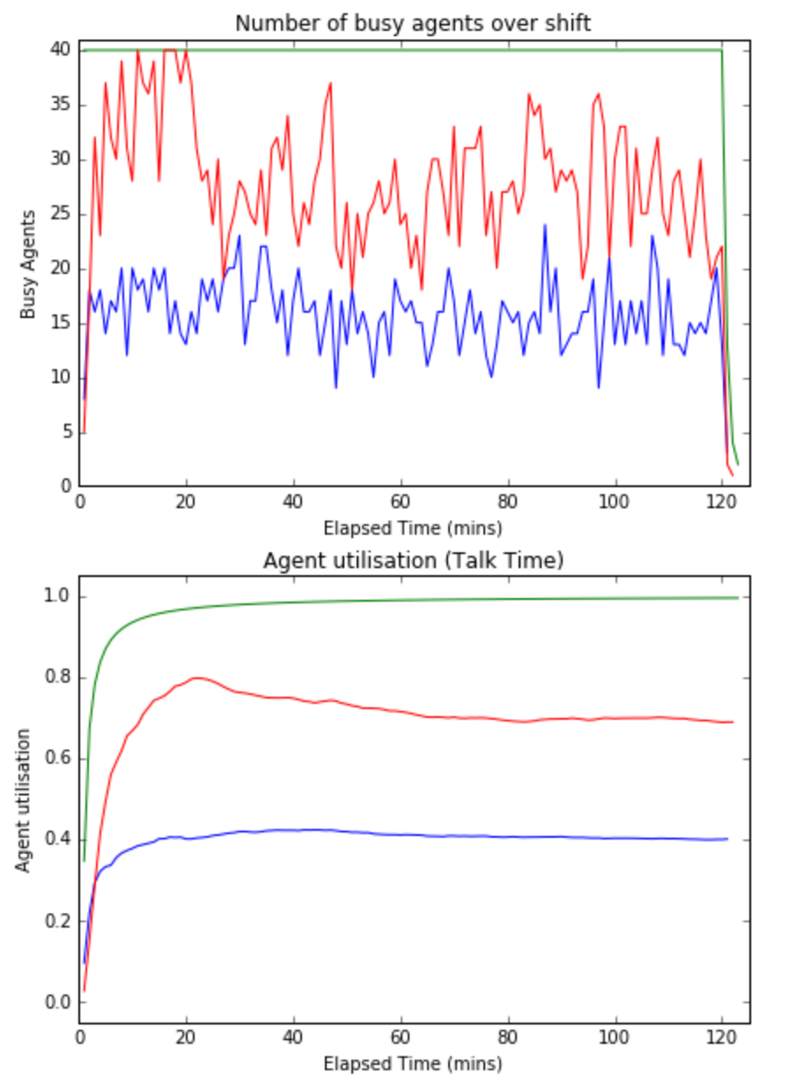
Maximising Agent Utilisation

Slide 15
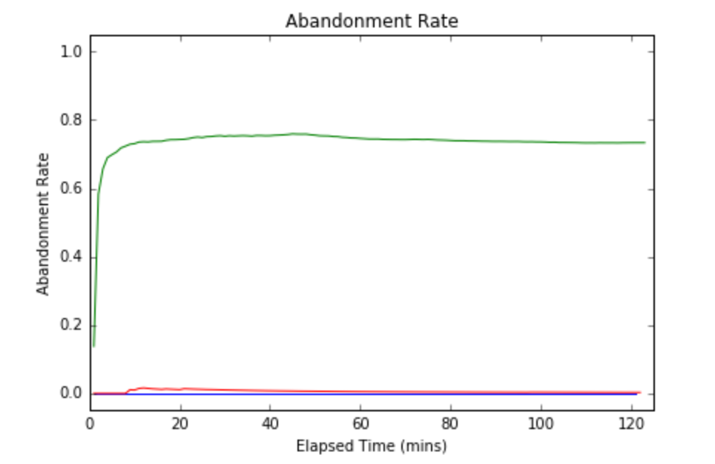
Maximising Agent Utilisation

Slide 16
Optimisation Problem
Maximise Agent Utilisation
Minimise Abandonment Rate (keep under pre-defined limit, e.g. 5%)
Minimise Trunk (telephone lines) Usage

Slide 17
Comparison of Algorithms
Progressive Dialing
make a call when an agent becomes free
Simple Predictive Dialing
generate set number calls/sec
Analytic Methods
E.g. based on probability theory, “Optimization of a Predictive Dialing Algorithm”, Fourati & Tabbane
Machine Learning Methods
E.g. genetic algorithm: “Predictive Dialer Intensity Optimization Using Genetic Algorithms”, Amaral & Vital

Slide 18
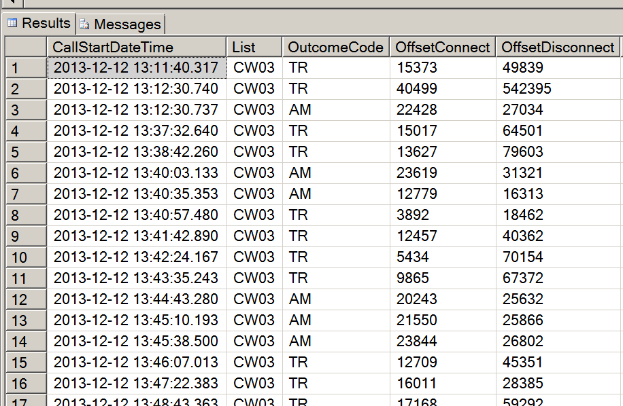
Simulator
Load Simulation Data
Run Simulation
Evaluate Model
while still-running:
calculate agent states
calculate call states
calculate new dial level
generate new calls
Use real data – not synthetic
No simulation code available - will publish simulator as open source project

Slide 19
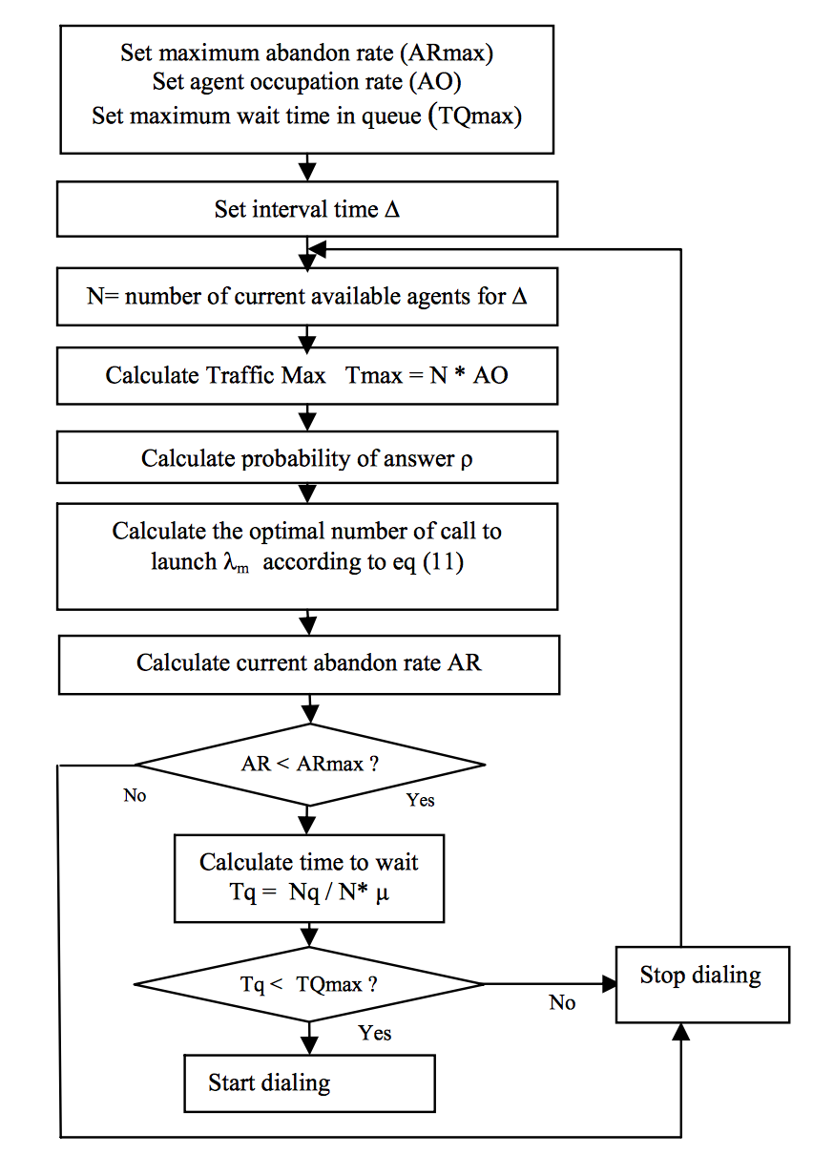
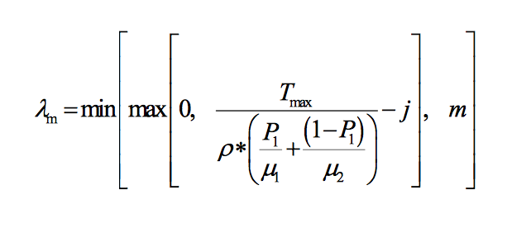
Analytic Model

Slide 20
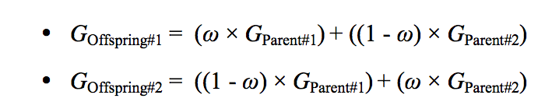
Genetic Algorithm
T – 1
(historical)
T
(dialing, calculate new dial level)
T + 1
(apply new dial level)
Crossover uses strategy based on random weights
Mutation, depending on mutation probability, stresses the offspring by adding random value +/- 50% original value
Small number of iterations (20) as required to run in small time frame.

Slide 21
Conclusions
Simple methods don’t handle change in conditions well
Analytic model didn’t produce the results stated in the paper
Difference between simulator using real call centre data vs synthetic data?
The genetic algorithm is sensitive to time frame
No common framework for simulation therefore hard to compare results
Will publish simulator as open source project to aid further studies

Slide 22
Further Work
Simulation
(Ensemble techniques)
Supervised Learning
(Neural Network)
Validate (and run in real-time environment)
New technique: Two Phase
Simulation to learn optimal dial level
Supervised learning to build model
Agent Simulation
Include agent events such as log on/log off
Use different types of campaigns
Telemarketing vs Market Research
Implement in a real call-centre
Real-time programming considerations

Slide 23
Thank-you

Slide 24
Footnote...
Are we solving the right problem?
Constraints:
Trunks

Slide 25
Footnote...
Are we solving the right problem?
Constraints:
Trunks Voice Over IP gives unlimited trunk capability

Slide 26
Footnote...
Are we solving the right problem?
Constraints:
Trunks Voice Over IP gives unlimited trunk capability
Agent Utilisation

Slide 27
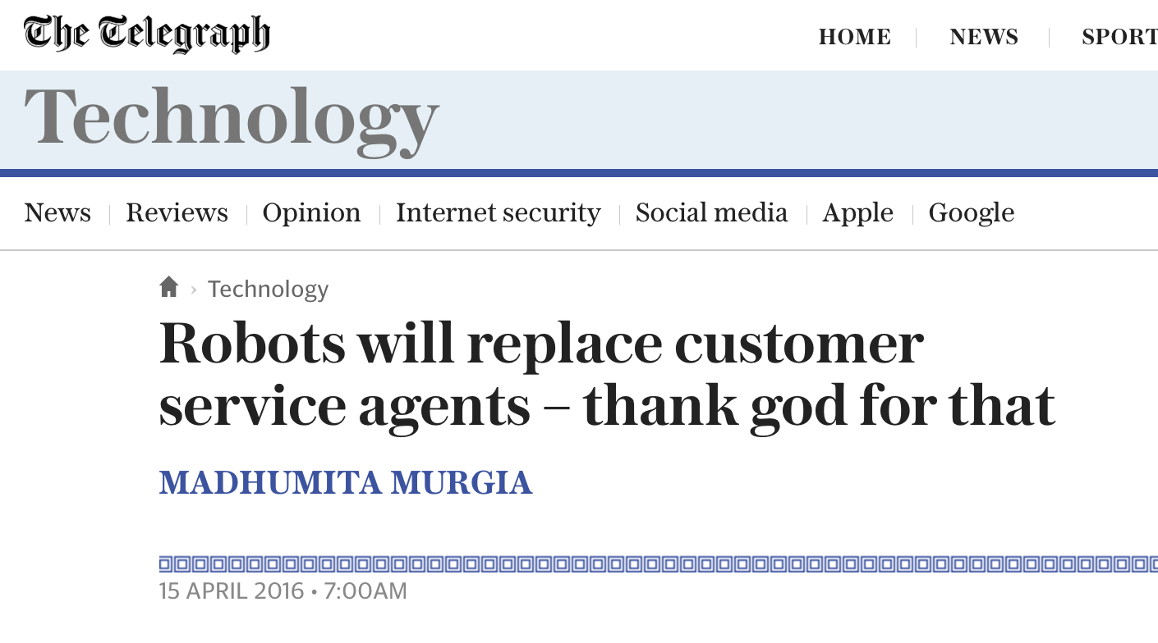
Footnote...
Are we solving the right problem?
Constraints:
Trunks Voice Over IP gives unlimited trunk capability
Agent Utilisation ChatBots
http://www.telegraph.co.uk/technology/2016/04/15/robots-will-replace-customer-service-agents--thank-god-for-that/

Slide 28
Footnote...
Are we solving the right problem?
Constraints:
Trunks Voice Over IP gives unlimited trunk capability
Agent Utilisation ChatBots
Abandonment Rate
http://www.telegraph.co.uk/technology/2016/04/15/robots-will-replace-customer-service-agents--thank-god-for-that/

Slide 29
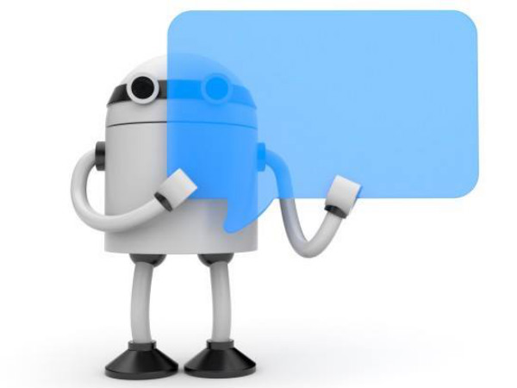
Footnote...
Are we solving the right problem?
Constraints:
Trunks Voice Over IP gives unlimited trunk capability
Agent Utilisation ChatBots
Abandonment Rate Who cares? Bots are cheap!!
http://www.gizbot.com/apps/features/5-reasons-that-make-google-chatbot-hit-and-miss-in-india-032835.html

Slide 30
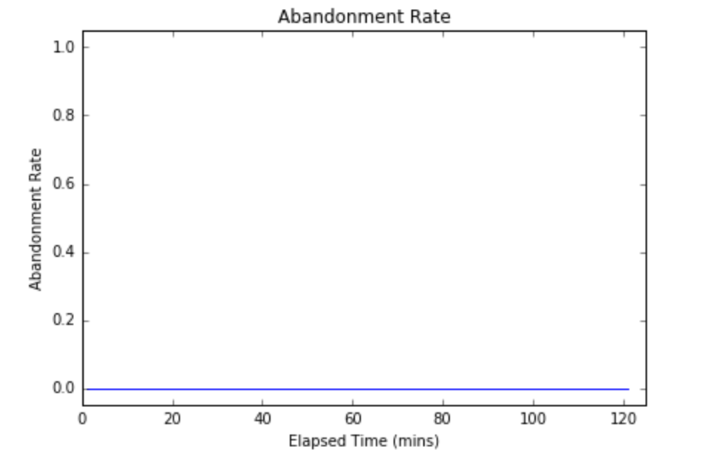
Maximising Agent Utilisation (1 call/sec)

Slide 31
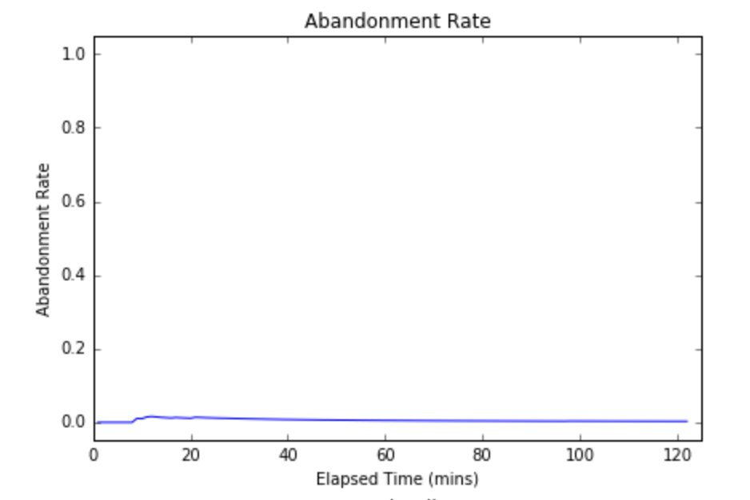
Maximising Agent Utilisation (5 call/sec)

Slide 32
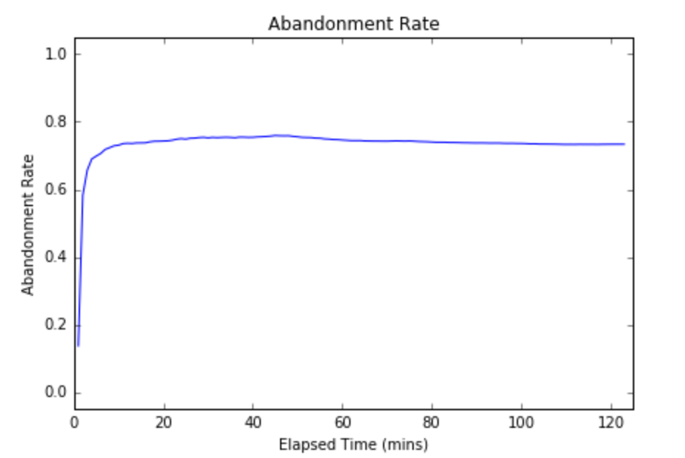
Maximising Agent Utilisation (10 call/sec)

